Slide 1
Employment Vs The Classroom: High School Edition
Isaac, Tanner, Jacobus, Art

Slide 2
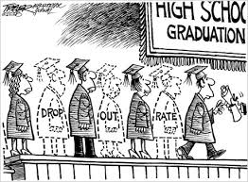
The Problem
Does high school employment affect high school dropout rates?
Does parent wage affect high school dropout rates?
If so, how?
Notes:
TANNER - How/why did we chose this question? Go into how we will see if these datasets are correlated by calculating the slope of the line at set intervals in each graph, and see if the slopes (either being +/-) for patterns/match up - which might lead to correlation.

Slide 3
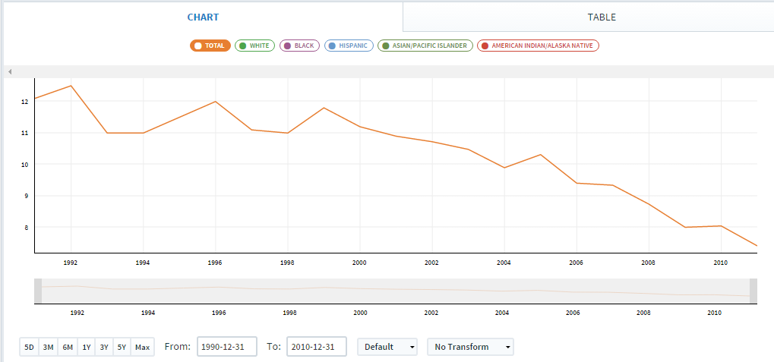
Dropout Rate by Race
Notes:
JACOBUS - We should show explain what the data is (what are the axis variables). Also should show graphs of three data sets ← maybe. What data attributes are used (of all the columns in the datasets, what columns did we pick and why?
Dropout Rate by Race:
Main graph we used for comparison.
x-axis: Years measured
y-axis: Percentage of selected Race that has dropped out that year
This one we obviously needed to pick because it is our control data. This gave us an idea as to what the dropout rates looked like over the years. We are able to see that the dropout rates steadly decline over the years.
Measured slope every 5 years beginning in 1990 and going until 2010, to compare against other graphs to see if their is a correlation.

Slide 4
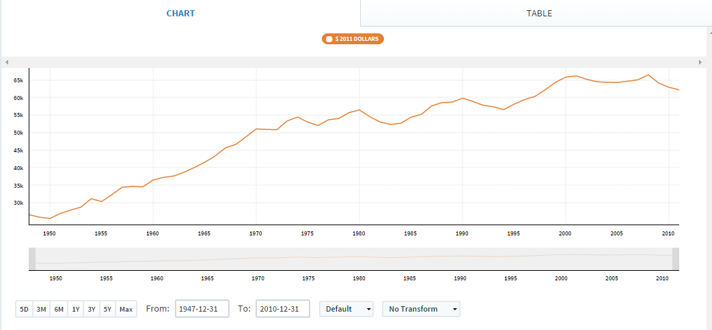
Median Family Income
Notes:
Median Family Income:
This graph allowed for us to see if when a median family income was higher or lower on average, and if it correlated with the dropout rates.
x: years
y: Median income
We thought that measuring the median family income would in some way show how the dropout rates lowered as income grew.

Slide 5
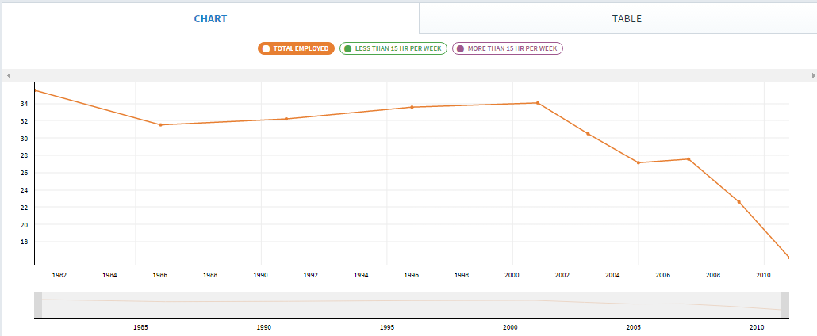
Percentage of High School Students aged 16 or older who are Employed by hours worked
Notes:
High School workers:
tricky.
x:years
y:% of total high school students who work at all.
We believed this dataset would show that as kids worked in high school they would be more likely to dropout. As the rates of kids working drops, the dropout rate remained unaffected.

Slide 6
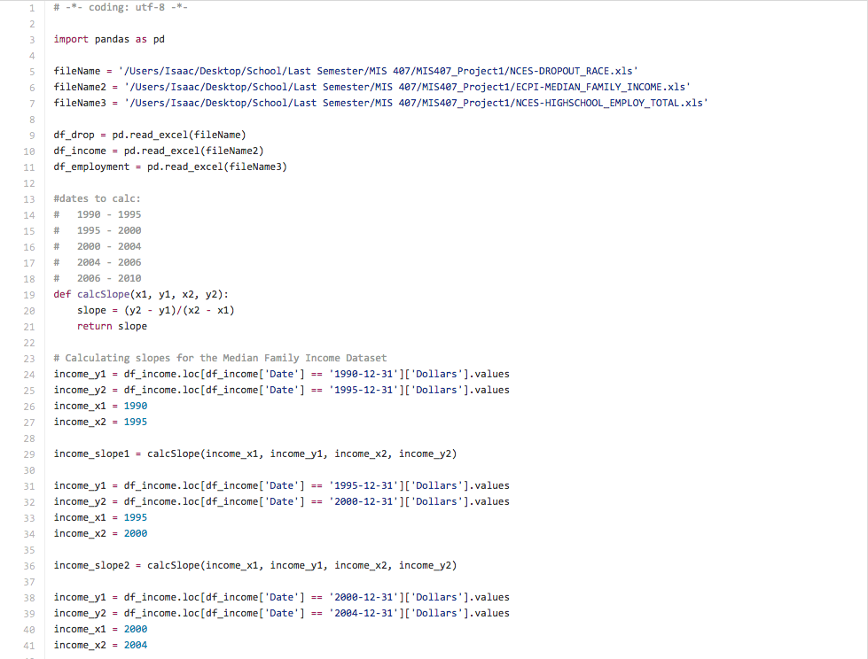
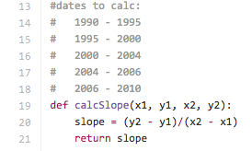
The Code
Excel files to variables
Create Pandas DataFrame
Function to calculate slope
Calculating slopes
Notes:
ISAAC

Slide 7
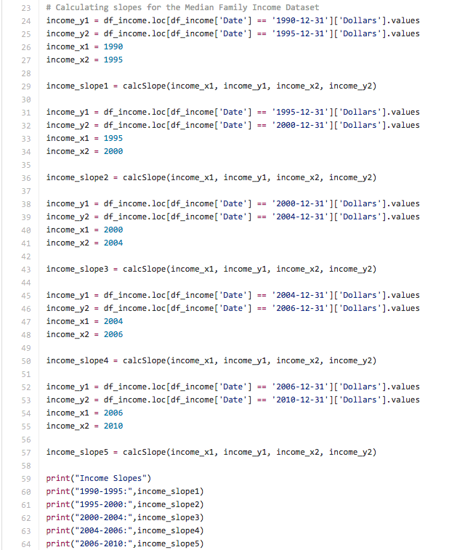

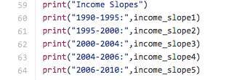
The Code
Notes:
ISAAC

Slide 8
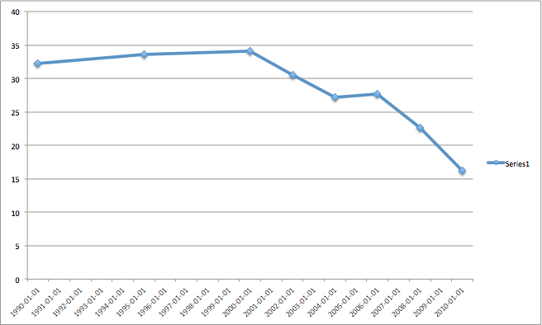

Results: High School Employment 1990-2010
Slopes
1990-1995: Positive
1995-2000: Positive
2000-2004: Negative
2004-2006: Positive
2006-2010: Negative
+
+
-
+
-
Notes:
Art- code output + results

Slide 9
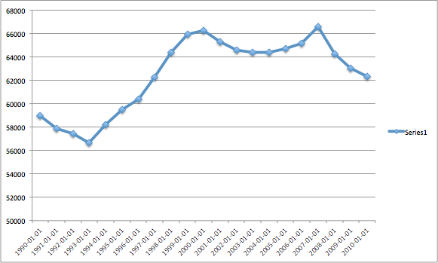

Results: Median Family Income 1990-2010
Slopes
1990-1995: Positive
1995-2000: Positive
2000-2004: Negative
2004-2006: Positive
2006-2010: Negative
+
+
-
+
-
Notes:
Art- code output + results

Slide 10
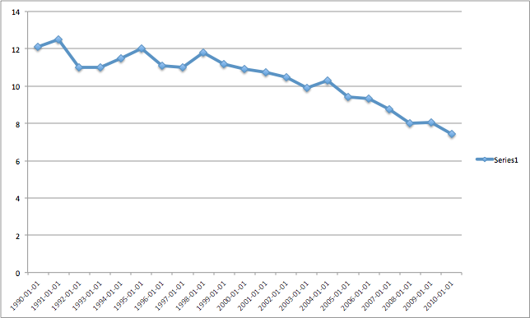

Results: High School Dropout Rate 1990-2010
Slopes
1990-1995: Negative
1995-2000: Negative
2000-2004: Negative
2004-2006: Negative
2006-2010: Negative
-
-
-
-
-
Notes:
Art- code output + results

Slide 11


Conclusion
Two variables matched, although coincidental
High School Employment
Median Family Income
Dropout Rate
Wide range of possible influences
As the Mythbusters would say: Plausible!
Notes:
Art - The slopes for Income and HS Employment were identical (just a coincidental pattern). So we can probably rule no correlation/undetermined with the data we used - there are so many factors that play into this that we did not use, just picking three and see if they correlate was a long shot in 20/20 hindsight. - maybe add an image to fit the slide to help fill up space and make it more visually appealing.

Slide 12



Questions?

